Slide 1
Analytical Methods : Critical Frameworks
Feb’10
Sankalp Mathur (sankalp.mathur@gmail.com)

Slide 2
Topics
Canonical Analysis
PROC CANCORR
Principal Component and Factor Analysis
PROC PRINCOMP
Discriminant Analysis
PROC DISCRIM
Power Analysis

Slide 3
Canonical Analysis
Canonical Correlation Analysis is a method for investigation of relationships between a set of variables
More specifically if we have x_{i}’s and y_{i}’s , the analysis is critical in finding the linear combination of x_{i}’s and y_{i}’s which have maximum correlation with each other (These linear combinations are called latent variables or canonical variate’s)
If the scenario be represented by random variable column vectors
and the canonical analysis seeks vectors a and b such that the random variables a'X and b'Y maximize the correlation
a'X and b'Y are the first pair of canonical roots, subsequently the procedure is repeated min(m,n) times subject to constraint of roots being minimally correlated

Slide 4
Canonical Analysis : Illustration
Solution
Correlation (r) = 0.9194
Std Dev Lat Var 1 = 2.6
Std Dev Lat Var 2 = 2.56
Compute the values of a,b,c,d,e,f so that the correlation between the two latent variables is maximized
First Canonical Root

Slide 5
Canonical Analysis : Illustration
First Canonical Variates
New Latent Variables
Minimize
Minimize
Maximize
Compute the value of a,b,c,d,e,f to maximize the correlation between the two latent variables and minimize the correlation between the first canonical root and the second one being calculated

Slide 6
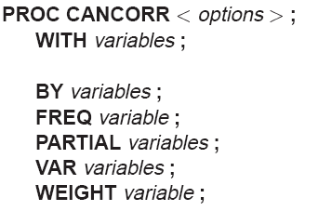
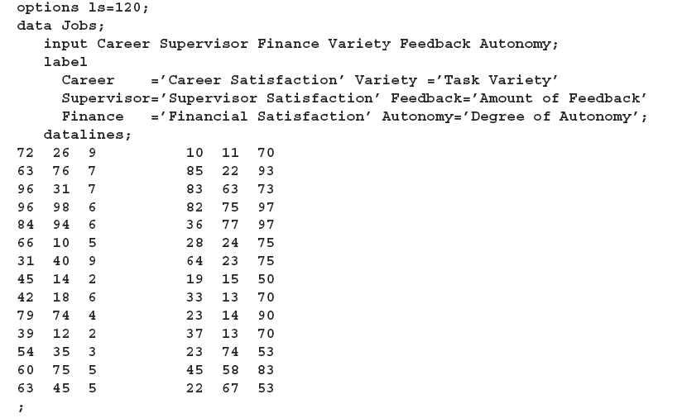
PROC CANCORR
PROC CANCORR and WITH statements are mandatory
Procedure performs canonical correlation, partial canonical correlation and canonical redundancy analysis
Data is used for determination of degree of correspondence between job characteristics and satisafaction where characteristics are defined by career track, supervisor satisfaction and financial benefits while satisfaction is measured by task variety, feedback provided and degree of autonomy required to do the task

Slide 7
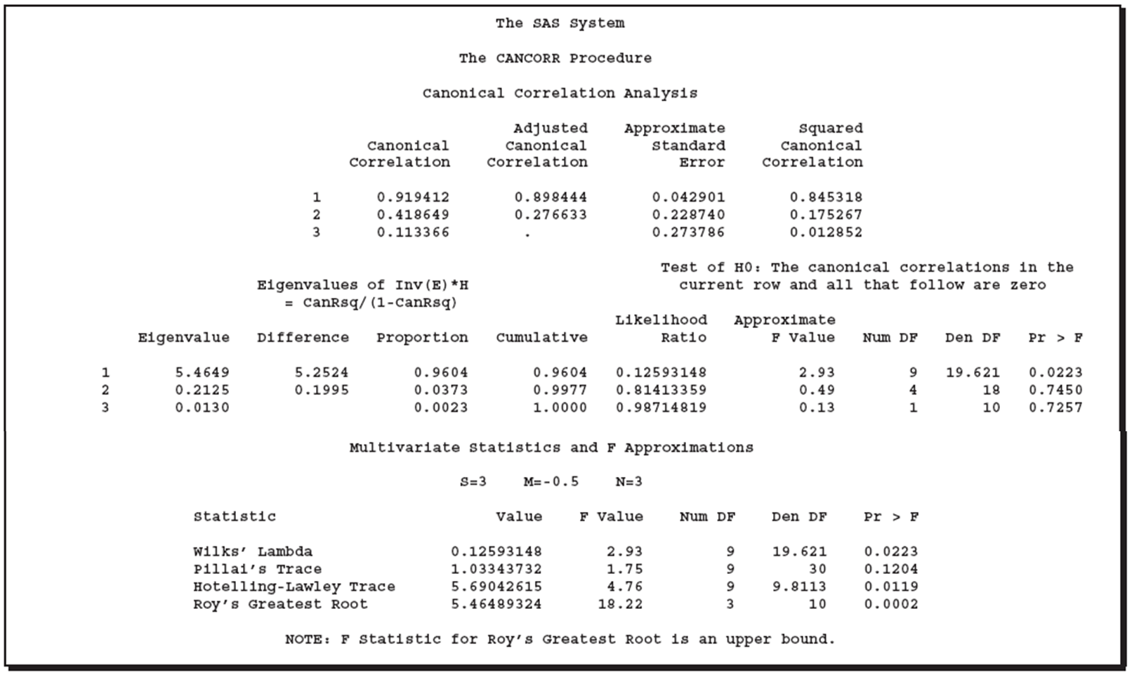
PROC CANCORR
Notice the reducing order of correlation at each step
Correlation between first two latent variables
Correlation between second two latent variables
Correlation between third two latent variables
EigenValue = r²/(1-r²)
Measures of significance show only greatest root is significant

Slide 8
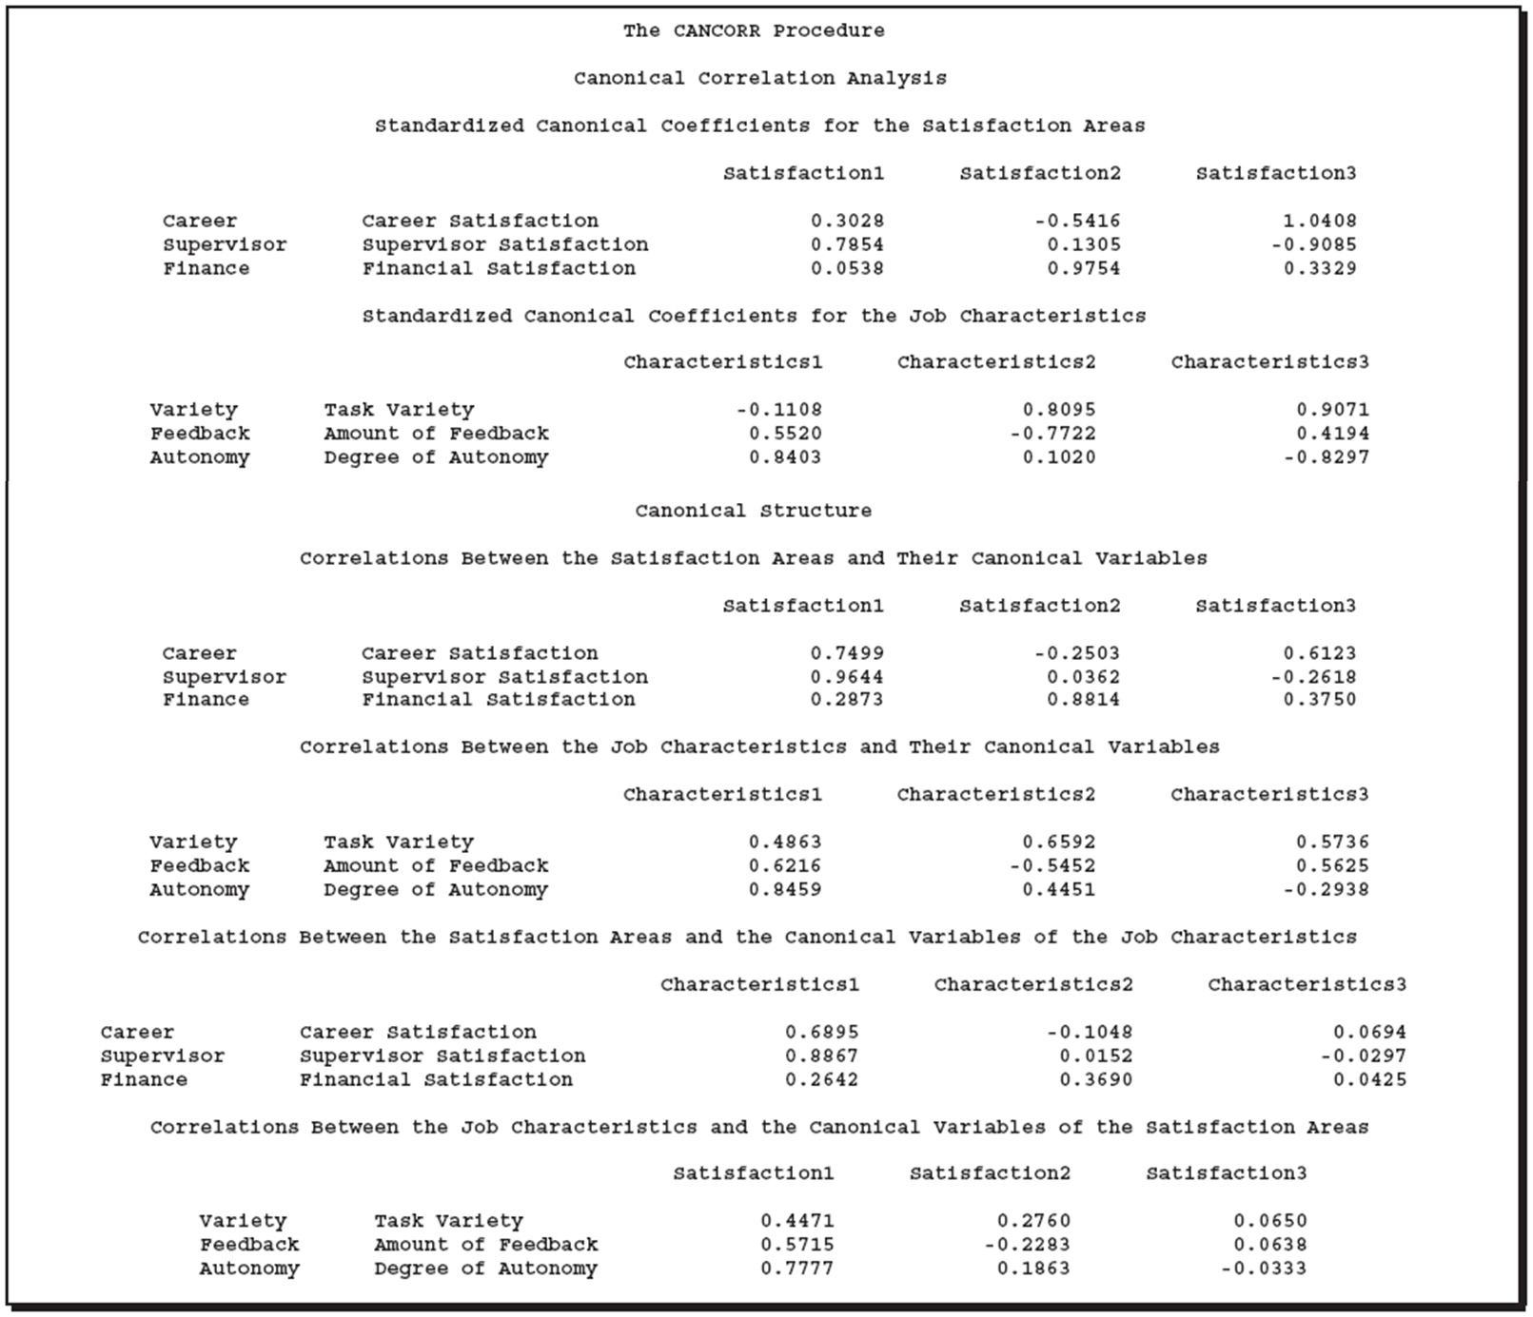
PROC CANCORR
3Pairs of canonical roots
Correlation Matrices

Slide 9
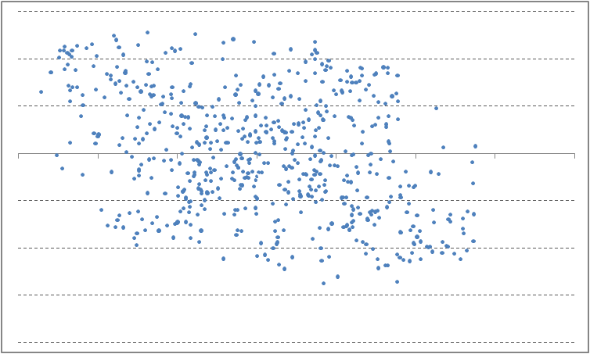
Principal Component Analysis
Principal Component Analysis is mathematically defined as orthogonal linear transformation that transforms the data into a new co-ordinate system such the maximum variance by any projection of the data comes on its first (or principal axis)
Second Greatest Variance occurs on the second principal axis
For a data matrix, X^{T}, with zero empirical mean, where each row represents a different repetition of the experiment, and each column gives the results from a particular probe, the PCA transformation is given by: where W Σ V^{T} is the singular value decomposition (svd) of X
Second Principal Axis
First Principal Axis

Slide 10
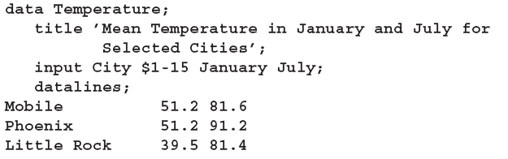
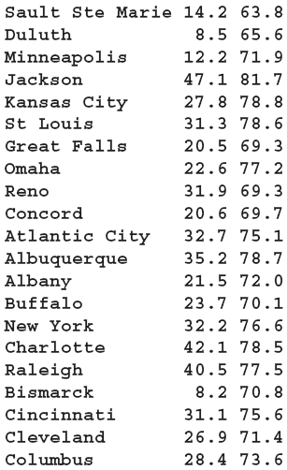
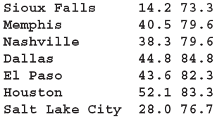
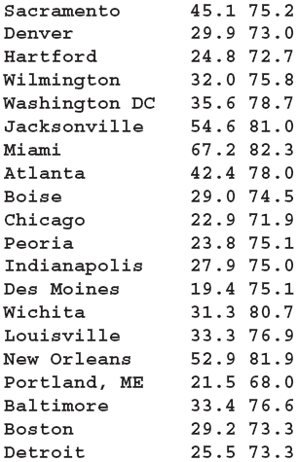
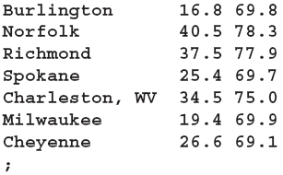
PROC PRINCOMP
The PRINCOMP procedure performs principal component analysis. As input you can use raw data, a correlation matrix, a covariance matrix, or a sums of squares and cross-products (SSCP) matrix.
The following example uses the PRINCOMP procedure to analyze mean daily temperatures
in selected cities in January and July.

Slide 11
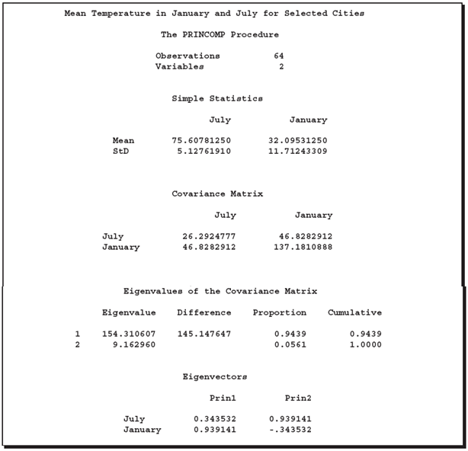
PROC PRINCOMP

Slide 12
Discriminant Analysis
Discriminant Analysis develops a criterion to classify each observation into a group. It is used to variables which discriminate between two or more naturally occurring groups.
Criterion is determined by a measure of generalized square distance – Mahalanobis or Euclidean
Discriminant Analysis is different from clustering in a way that the prior knowledge of the classes is required
For Criterion Development : We fit a linear equation of the type: Group = a + b₁*x₁ + b₂*x₂ + ... + b_{m}*x_{m} where a is a constant and b₁ through b_{m} are regression coefficients for all the groups
For Classification : The value for each group is estimated as above and the groups where the value is highest is assigned

Slide 13
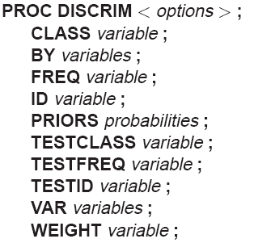
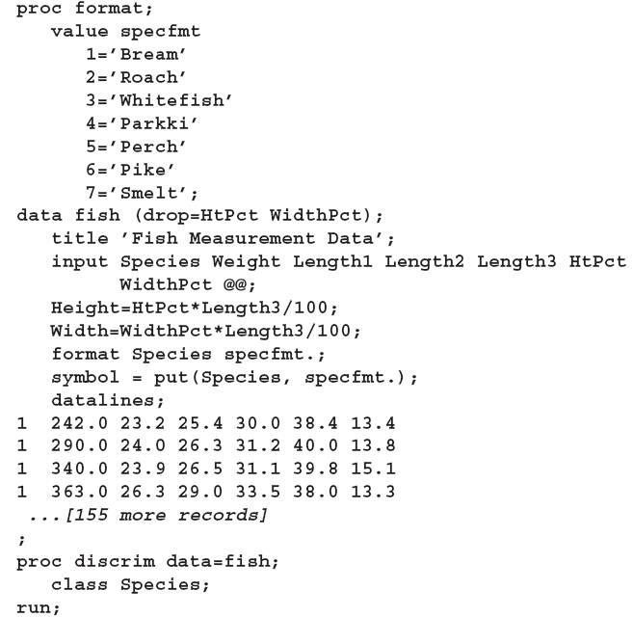
PROC DISCRIM
The data in this example are measurements taken on 159 fish caught off the coast of Finland. The species, weight and dimensions are tallied. The goal now is to find a discriminant function based on these variables that best classifies the species.
This procedure is used to develop
a criterion to classify each obs into one of the groups. The derived
criterion from this data set can be applied to a second data set
during the same execution of PROC DISCRIM

Slide 14
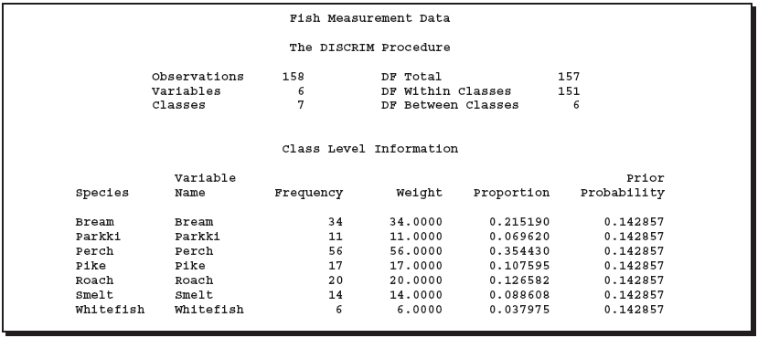

PROC DISCRIM

Slide 15
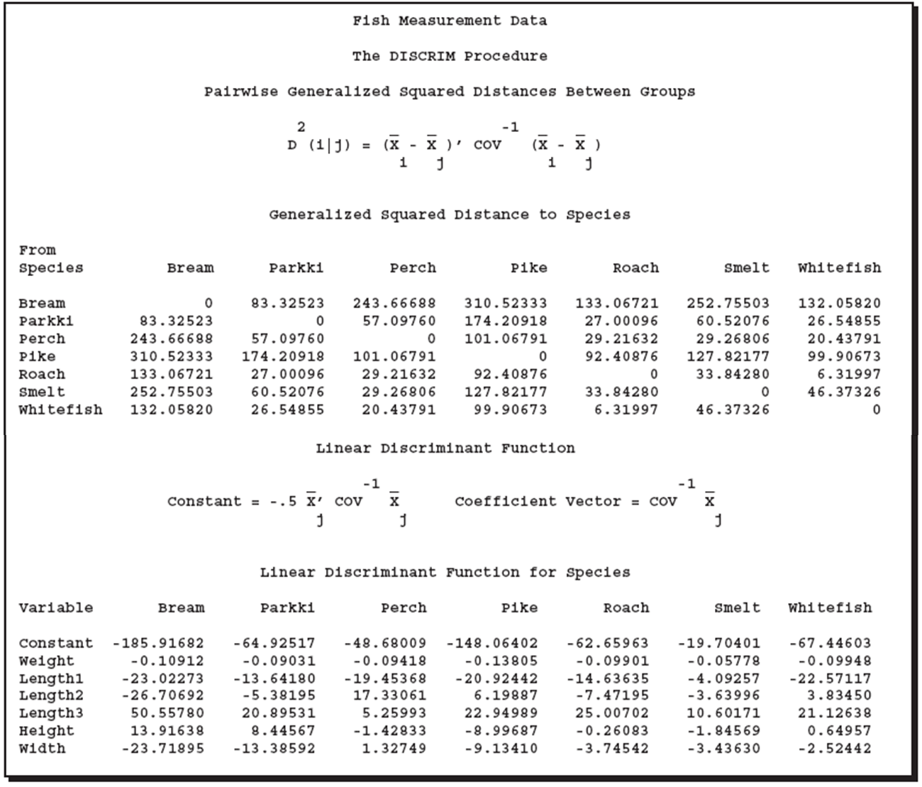
PROC DISCRIM

Slide 16
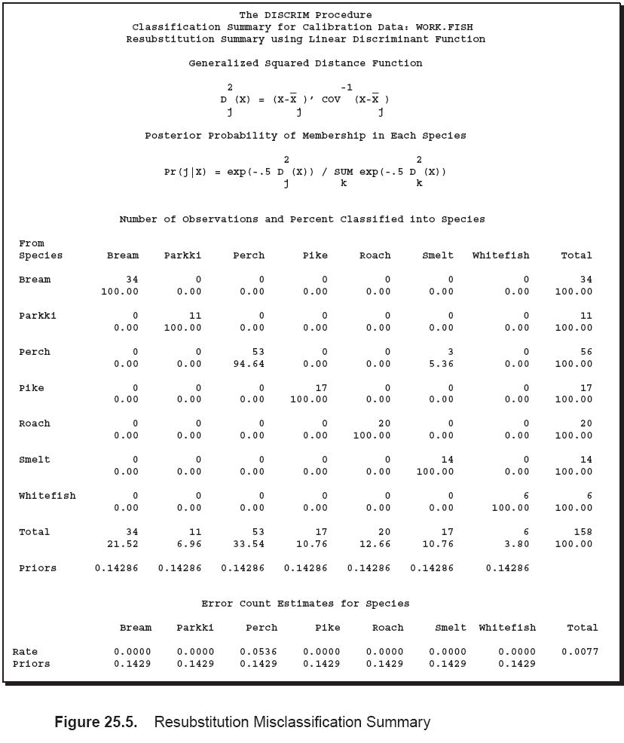
PROC DISCRIM

